Slide 1

Web Server

Slide 2

Content
1
Nginx Introduction
2
Nginx
Components
3
Nginx
Use Cases
4
Nginx
Demo

Slide 3
Nginx
Introduction

Slide 4
What is Nginx ?
Nginx, pronounced like “engine-ex”, is an open-source web server that, since its initial success as a web server, is now also used as a reverse proxy, HTTP cache, and load balancer.
Some high-profile companies using Nginx include Autodesk, Atlassian, Intuit, T-Mobile, GitLab, DuckDuckGo, Microsoft, IBM, Google, Adobe, Salesforce, VMWare, Xerox, LinkedIn, Cisco, Facebook, Target, Citrix Systems, Twitter, Apple, Intel, and many more (source).

Slide 5
History
Igor Sysoev originally wrote NGINX to solve problem of the difficulty that existing web servers experienced in handling large numbers (the 10K) of concurrent connections. With its event‑driven, asynchronous architecture.
NGINX revolutionized how servers operate in high‑performance contexts and became the fastest web server available.

Slide 6
History - Cont.
After open sourcing the project in 2004 and watching its use grow exponentially, Sysoev co‑founded NGINX, Inc. to support continued development of NGINX and to market NGINX Plus as a commercial product with additional features designed for enterprise customers.
Today, NGINX and NGINX Plus can handle hundreds of thousands of concurrent connections, and power more of the million busiest sites on the Web than any other server.

Slide 7
NGINX as a Web Server
The goal behind NGINX was to create the fastest web server around, and maintaining that excellence is still a central goal of the project.
NGINX consistently beats Apache and other servers in benchmarks measuring web server performance. Since the original release of NGINX.
NGINX has grown along with it and now supports all the components of the modern Web, including WebSocket, HTTP/2, gRPC, and streaming of multiple video formats (HDS, HLS, RTMP, and others).

Slide 8
Nginx
Components

Slide 9
Installing Nginx
Debian and Ubuntu
sudo apt-get update
sudo apt-get install nginx
RedHat / CentOS
sudo yum install epel-release
sudo yum update
sudo yum install nginx

Slide 10
Main configuration file
The Main configuration file /etc/nginx/nginx.conf
You can check the syntax of it before restarting the server by running: nginx -t
You can get more info about nginx by : nginx -h

Slide 11
Log files
The log files are located in /var/log/nginx
Under this directory we will find two files
access.log & error.log

Slide 12
Nginx configuration context
1
The Main Context
2
The Event Context
3
The HTTP Context
4
The Server Context
5
The Location Context
6
The Upstream Context

Slide 13
The Main Context
The main context is placed at the beginning of the core Nginx configuration file. The directives for this context cannot be inherited in any other context and therefore can't be overridden.
The main context is used to configure details that affect the entire application on a basic level. Some common details that are configured in the main context are the user and group to run the worker processes and the file to save the main process ID.
# The main context is here,
outside any other contexts
. . .
context {
. . .
}

Slide 14
The Event Context
The events context sets global options for connection processing. The events context is contained within the main context. There can be only one event context defined within Nginx configuration.
Nginx uses an event-based connection processing model, so the directive defined within this context determines how worker processes should handle connections.
# main context
events {
# events context
. . .
}

Slide 15
The HTTP Context
When configuring Nginx as a web server or reverse proxy, the “http” context will hold the majority of the configuration. This context will contain all of the directives and other contexts necessary to define how the program will handle HTTP or HTTPS connections.
The http context is a sibling of the events context, so they should be listed side-by-side, rather than nested.
# main context
events {
# events context
. . .
}
http {
# http context
. . .
}

Slide 16
The Server Context
# main context
http {
# http context
server {
# first server context
}
server {
# second server context
}
}
The “server” context is declared within the “http” context. This is our first example of nested, bracketed contexts. It is also the first context that allows for multiple declarations.
There can be multiple server contexts inside the HTTP context. The directives inside the server context handle the processing of requests for resources associated with a particular domain or IP address.

Slide 17
The Location Context
Location contexts define directives to handle the request of the client. When any request for resource arrives at Nginx, it will try to match the URI (Uniform Resource Identifier) to one of the locations and handle it accordingly.
# main context
server {
# server context
location /match/criteria {
# first location context
}

Slide 18
The Upstream Context
The upstream context is used to configure and define an upstream server. This context is allowed to define a pool of backend servers that Nginx can proxy the used when request. This context is usually we are configuring proxies of various types.
Upstream context enables Nginx to perform load balancing while proxying the request. This context is defined inside the HTTP context and outside any server context.
# main context
http {
# http context
upstream upstream_name {
server proxy_server1;
server proxy_server2;
}
server {
# server context
}
}

Slide 19
Configuration Contexts
Main
Events
HTTP
Server
Location
Upstream

Slide 20
Nginx
Use Cases

Slide 21
Nginx Use cases
Web Server
Proxy
Reverse proxy
Load
Balancer
Cache
Web App
Firewall
Internal DDos Protection
API Gateway
K8s IC

Slide 22
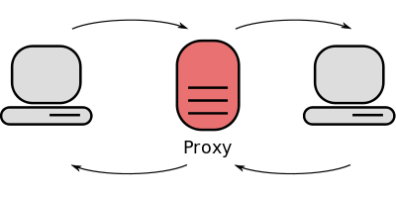
Forward Proxy
A forward proxy is what most people call ‘a proxy’. You send a connection request to it, and the forward proxy retrieves data from the internet. It usually lets clients on an otherwise firewall-restricted network to access the internet.
User
Website

Slide 23
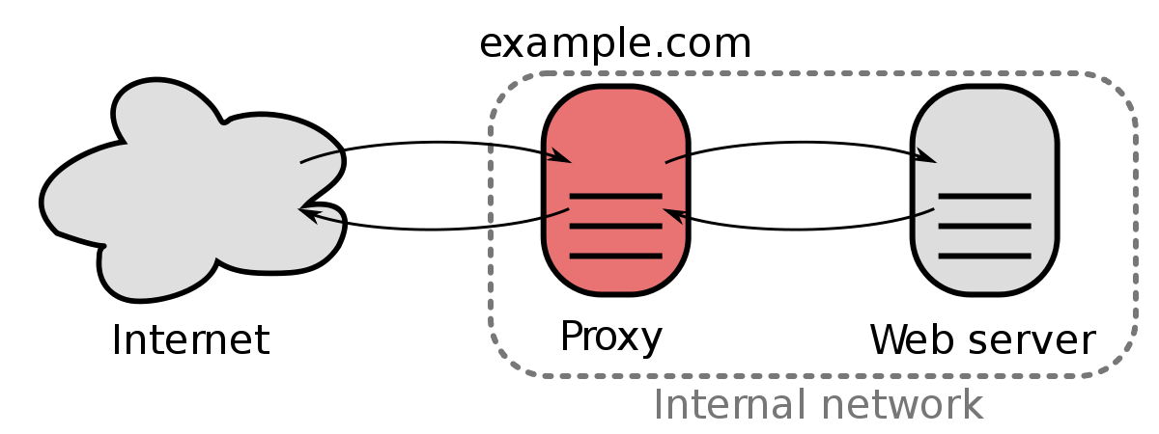
Reverse Proxy
A reverse proxy server is an intermediate connection point positioned at a network’s edge. It receives initial HTTP connection requests.
The reverse proxy serves as a gateway between users and your application origin server. In so doing it handles all policy management and traffic routing.

Slide 24
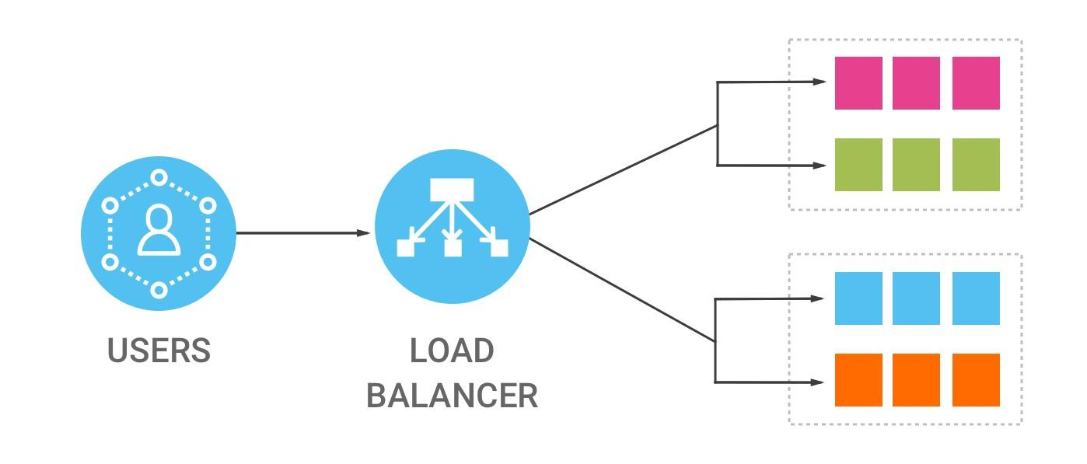
Nginx as LoadBalancer
Nginx can be configured as a simple yet powerful load balancer to improve your servers resource availability and efficiency.
Nginx acts as a single entry point to a distributed web application working on multiple separate servers.

Slide 25
Nginx
Demo

Slide 26
Nginx Demo
User
x.x.x.x
Nginx
LoadBalancer
Nginx
Webserver
Apache
Server

Slide 27
Nginx Lab
Install Nginx
Change the default file (index.html) to (yourName.html)
Make two html files, and change the configuration file to access the first file on port 81, and access the second file on port 82.
Tell me the main differences between Apache & Nginx

Slide 28
Thanks!
Do you have any questions?

